Slide 1
Final Project Presentation
Machine Learning CSCI 4050
Jefferson Xie 100619840
Notes:
Hello, this is a presentation for the final project of Machine Learning csci 4050

Slide 2
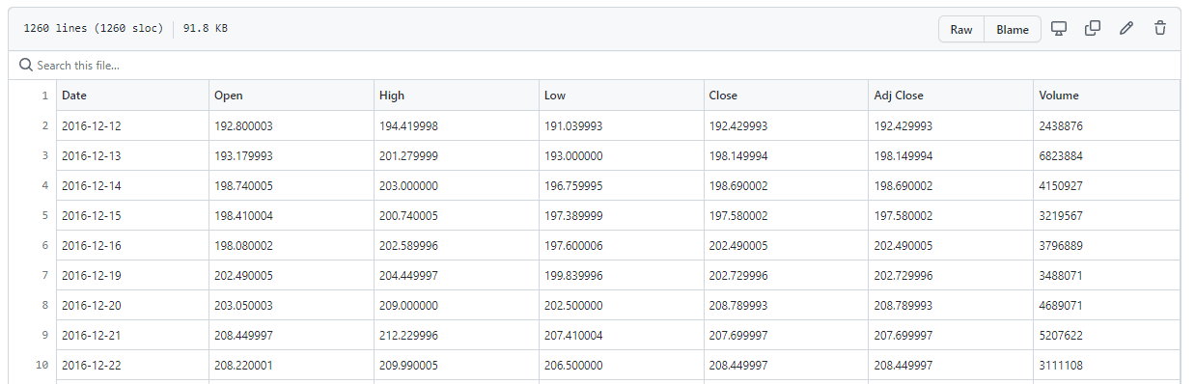
Data
Data set used will be Tesla Stock Market taken from YahooFinance
Notes:
Data is taken from YahooFinance.
Stock market prices for Tesla was downloaded over a 5 year period for evaluation
CSV is uploaded to github for an easier time uploading to google colab

Slide 3
Problem
Evaluate the usefulness of a stacked LSTM model on predicting stock market prices
Notes:
Problem to be analyzed is to see how well an LSTM model can predict future stock market prices.
As we learned in class, LSTM networks is useful for classifying, processing and making predictions on time series data.
So in this case I decided to use it on stock market prices to see how well it can predict future market prices.

Slide 4
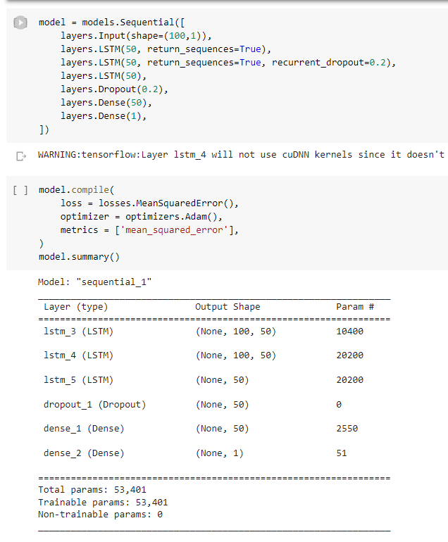
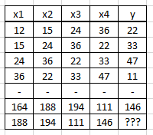
Design
Prepare Data
Stacked LSTM Model
Auto Regression
Evaluate
Notes:
The LSTM model will be relatively basic in that it will just be a sequential model using 3 stacked LSTM layers, one of which will have a recurrent dropout which should help with prediction accuracy. After the final LSTM layer, there will be one more dropout layer and dense layer before the final output layer.
What was more interesting was learning about auto regression while looking up how other people have done time series predictions.
The auto regression approach is a linear regression model that uses lagged variables as input variables. In terms of my project and stock market predictions, we generate a new matrix where each row’s value is based on a previous x amount of days. In this picture example, it uses 4 steps/lags
For the stock market case I used 100 previous days.

Slide 5
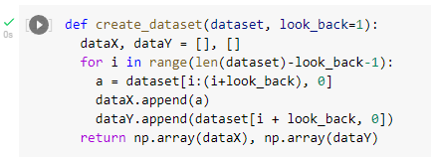
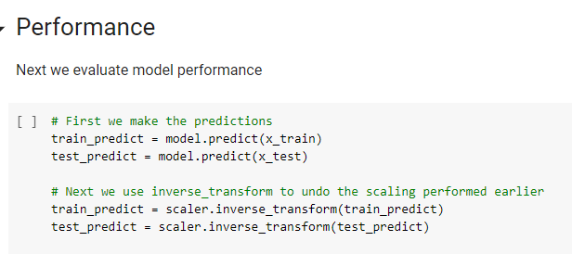
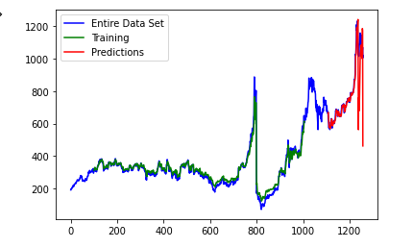
Implementation
Notes:
Attached here are pictures for the method on how to create a linear regression data matrix taken from Machine Learning Mastery.
You can also see that I trained the model with 200 epochs with a batch size of 64.
Next we use the model to get the prediction values for the training data set and the test data set, before apply inverse_transformations on them to get back the original stock market closing values to be graphed.

Slide 6
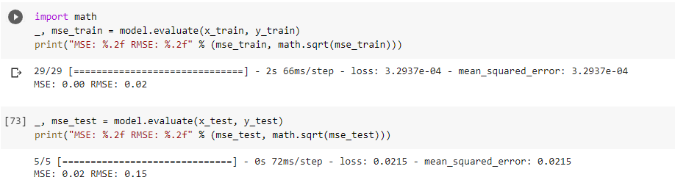
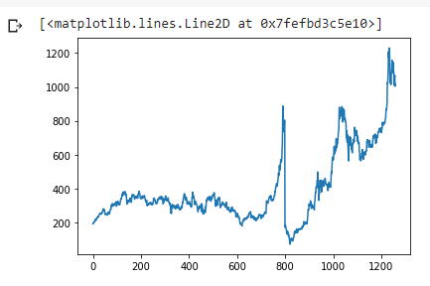
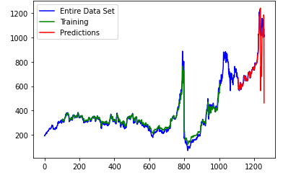
Summary of Evaluation
Notes:
From the results, we can see that the training data had a RMS value of 0.02 while the test data had an RMS of 0.15. This indicates that while the model fitted the training data very well, it could see significant improvements for the test data. Visually, we can see that while it was able to have a very accurate prediction over the initial period, it seems to have had issues accurately predicting the later half, however it does correctly predict that the market would be on a downward trend.
Overall, I think that stacked LSTM does seem to have a good chance of accurately predicting stock market prices, however instead of using a linear regression of previous days closing markets, there are probably better metrics to be used. Some of such metrics could be the company’s price to earning ratio, debt-to-equity ratio, and internet traffic.

Slide 7
Citations:
https://machinelearningmastery.com/time-series-prediction-with-deep-learning-in-python-with-keras/
https://machinelearningmastery.com/reshape-input-data-long-short-term-memory-networks-keras/
https://finance.yahoo.com/

